Slide 1
Programming Fundamentals (SWE – 102)
Variable and Operators

Slide 2
Multiple Print() statement in python
print("Hello ”)
print(“Python ”)
print(“World”)
print("Sir Syed " + "University")
Output
Hello
Python
World
Sir Syed University

Slide 3
Using end= option in print() statement
end= in print() statement prints upcoming text on the same line rather than printing on the newline.
print("Hello”, end=“ ”)
print(“Python”)
print(“World”)
Output
Hello Python
World

Slide 4
Comments in Python
Comments are use for documentation and better understand of source in native language
Single Line Comments in Python
# Prints Hello Python World on to screen
print("Hello Python world!!!")
Multi-Line Comments in Python
Triple double quotations (“””) or Triple single quotations (‘’’) can be use for Multi-Line comment in python
You can comment multiple lines as follows −
“”” Comments “”” | ‘’’ Comments ‘’’

Slide 5
Escape Sequences in Python
Escape Sequences are use for formatting text in print() statement.
Type of escape sequences are \n,\t,\b,\’,\”,\r
print(“Hello\nWorld”)
Hello
World
print(“Hello\tWorld”) >> Hello World (8 spaces)
print(“Hello\bWorld”) >> HellWorld (one space back)
print(“Hello \’World\’ ”) >> Hello ‘World’ (single quote)
print(“Hello \”World\” “) >> Hello “World”(double quotes)
(NOTE: These escape sequences can be use in end= option in print())

Slide 6
Python Literals
Literals are fixed value either text, numbers, Boolean or any data form
Literals are the values which are assign to the variable.
Literals can be defined as the data is given to the variables and constants
There are many types of Literal in the Python:
Numeric Literals
String literals
Boolean literals
Special literals

Slide 7
Numeric Literals
Numeric Literals are immutable(unchangeable).
Numeric literals can belong to 3 different numerical types:
integer , float , complex

Slide 8
Example: how to use Numeric literals in Python
a = 0b1010 #Binary Literals
b = 103 #Decimal Literal
#Float Literal
float_1 = 10.5
float_2 = 1.5e2
#Complex Literal
x = 3.14j

Slide 9
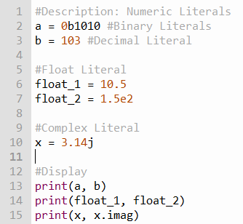


Slide 10
String literals
String literal is a text or group of characters enclosed in single or double quotations.
Multiline in ‘’’ ‘’’
A string literal is a sequence of characters surrounded by quotes.
We can use both single, double or triple quotes for a string.
A character literal is a single character surrounded by single or double quotes.

Slide 11
Example: how to use String literals in Python
strings = “This is Python”
char = "C"
multiline_str = """This is a multiline string with more than one line code.""“

Slide 12
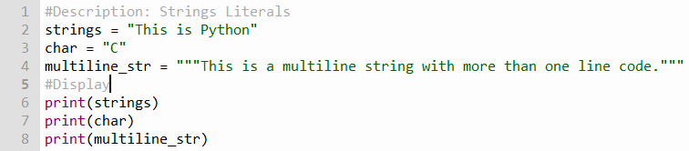


Slide 13
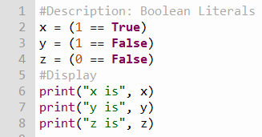

Boolean literals
A Boolean literal can have any of the two values: True or False.
Example: How to use Boolean literals in Python:

Slide 14

Special literals
Python contains one special literal i.e. None. We use it to specify that the field has not been created.
No value is assign to the variable.
Example: How to use Special literals in Python:

Slide 15
Variable:
Variables are nothing but reserved memory locations to store values.
This means that when you create a variable you reserve some space in memory.
Rules for Python variables:
A variable name must start with a letter or the underscore character
A variable name cannot start with a number
A variable name can only contain alpha-numeric characters and underscores (A-z, 0-9, and _ )
Variable names are case-sensitive (age, Age and AGE are three different variables)
In computer programming CamelCase or camelCase is often used as a naming convention for naming compound words variables, arrays, and other elements e.g maxNumber or MaxNumber, midTerm or MidTerm, fullName, FullName.

Slide 16
Naming of Variables:
Camel Case (myFirstCode = 5)
Pascal Case (MyFirstCode = 5)
Snake Case (my_ first_code = 5)

Slide 17
Assigning Values to Variables
Python variables do not need obvious declaration to reserve memory space.
The declaration happens automatically when you assign a value to a variable.
The equal sign (=) is used to assign values to variables.
variable_name = assign value(Literals)
E.g. : number = 10
name = “John”

Slide 18
Example
#Legal variable names: myvar = "John" my_var = "John" _my_var = "John" myVar = "John" MYVAR = "John" myvar2 = "John" #Illegal variable names: 2myvar = "John" my-var = "John" my var = "John"

Slide 19
Reserved words
You can not use reserved words as variable names / identifiers.
and , del ,for , is , raise , assert , elif , from lambda , return , break , else , global , not , try ,class , except , if , or ,while
Continue, exec, import , pass, yield,
def , ﬁnally, in , print

Slide 20
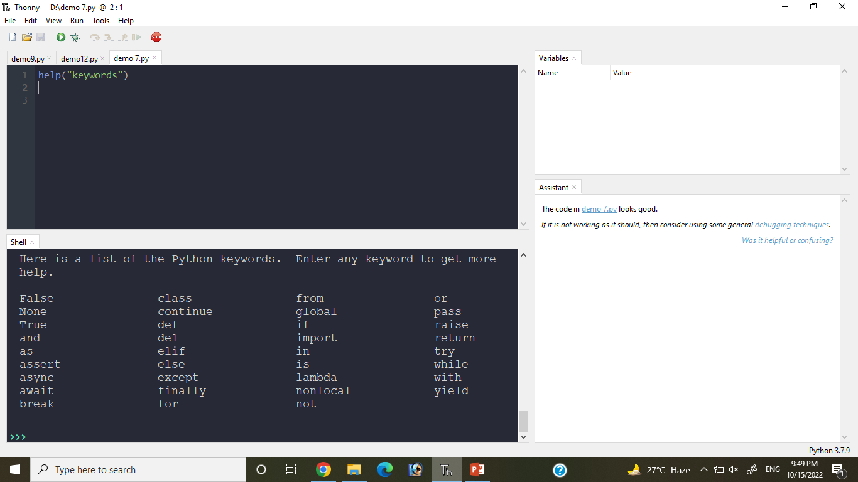
help(“keywords”)

Slide 21
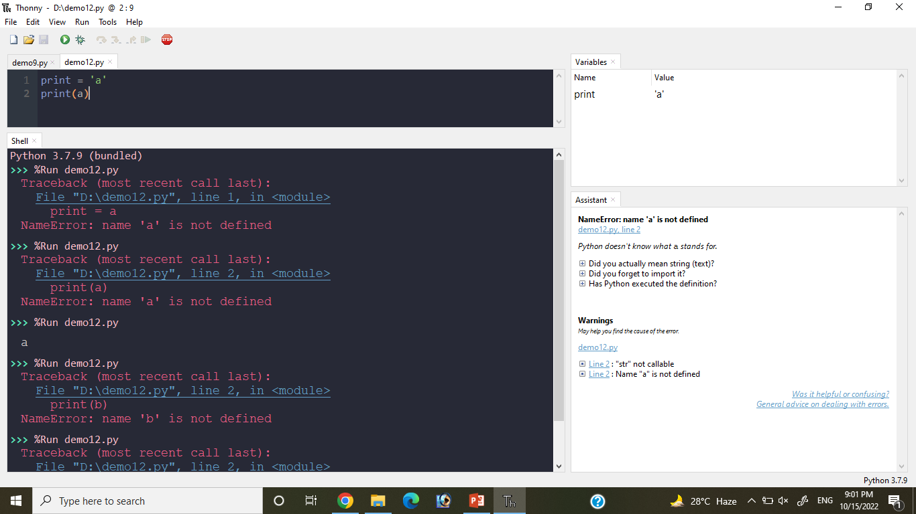

Slide 22
Multiple variables in one line
You can assign the same value to multiple variables in one line:
Example:
x = y = z = "Orange "
x,y,z = " Orange " , " Banana " , " Apple " print(x) print(y) print(z)

Slide 23
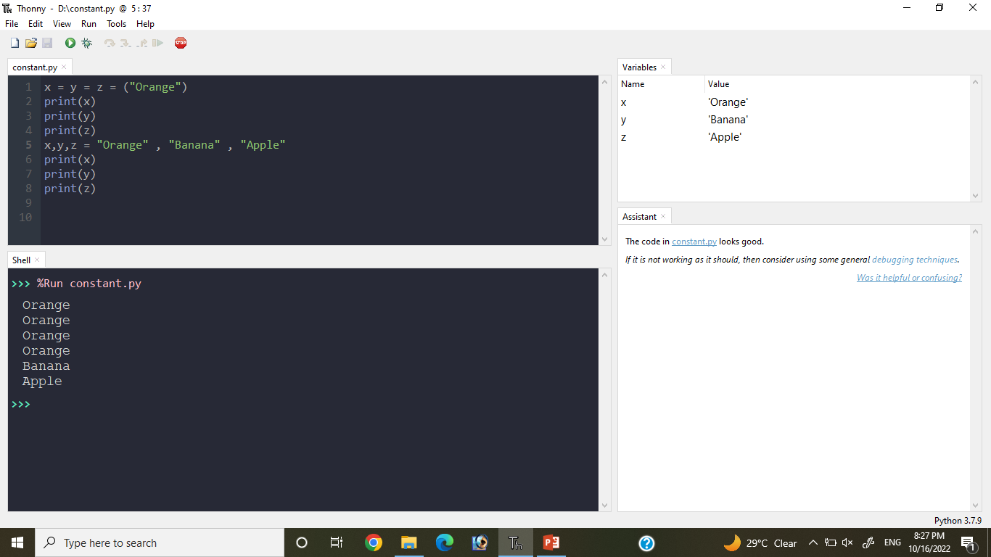

Slide 24
Constants
A constant is a type of variable whose value cannot be changed.
Assigning value to a constant:
Constants are usually declared and assigned on a module, module means a new file containing variables, functions etc. which is imported to main file. Or also declared same existing file.
Example: Declaring and assigning value to a constant
#Create a constant.py
PI = 3.14
GRAVITY = 9.8

Slide 25
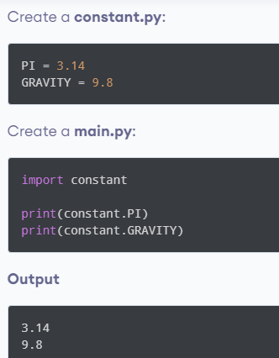

Slide 26
Example
Objective: Compute the area of a circle.
radius = 3 # Assign 3 to variable radius
PI=3.14 # declare a constant
#compute the area
area = PI * (radius * radius)
#Display result
print("The area of circle is" ,area,” sq cm”)

Slide 27
Python Data Types
In programming, data type is an important concept.
Variables can store data of different types, and different types can do different things.
Python has the following data types built-in by default, in these categories:
Text Type: | str
Numeric Types: | int, float, complex
Sequence Types: | list, tuple, range
Mapping Type: | dict
Boolean Type: | bool

Slide 28
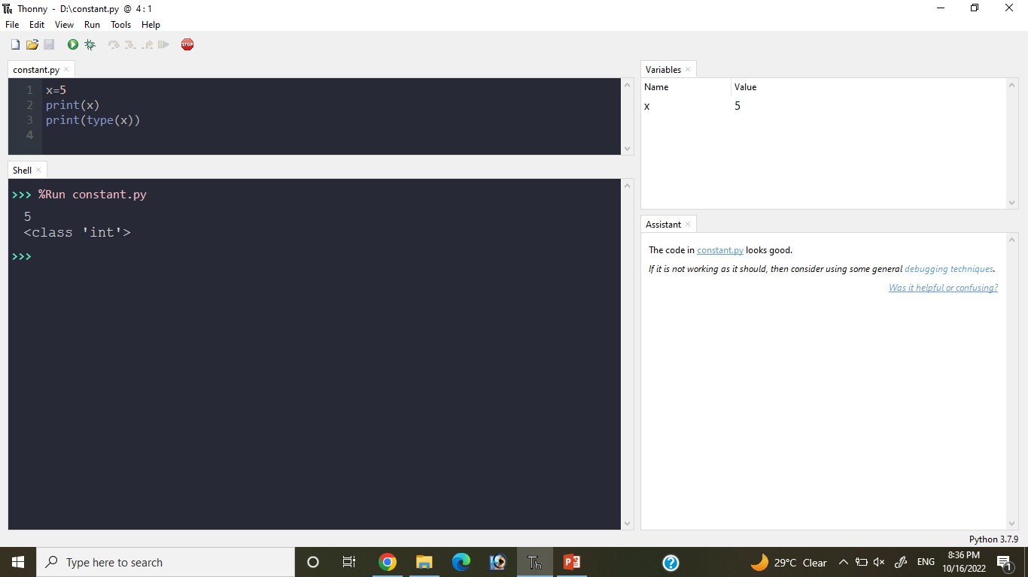
Getting the Data Type
You can get the data type of any object by using the type() function:
Example:
#Print the data type of the variable x:
x = 5 print(type(x)) -> int

Slide 29
LIST
x= [1,'hello', '@', 0.52, 'good morning‘]
List items are ordered, changeable(mutable), and allow duplicate values.
List items can be of any data type

Slide 30
Ordered and Unordered
When we say that datatypes are ordered, it means that the items have a defined order, and that order will not change.
Unordered means that the items does not have a defined order, you cannot refer to an item by using an index.

Slide 31
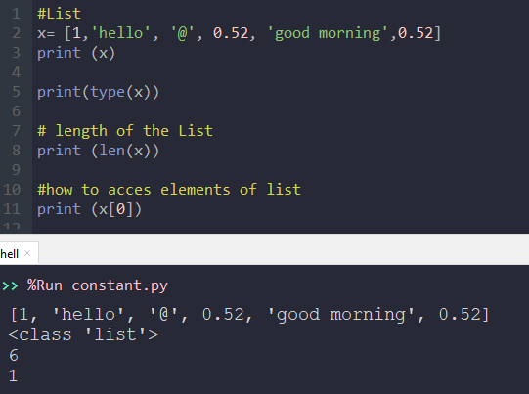

Slide 32
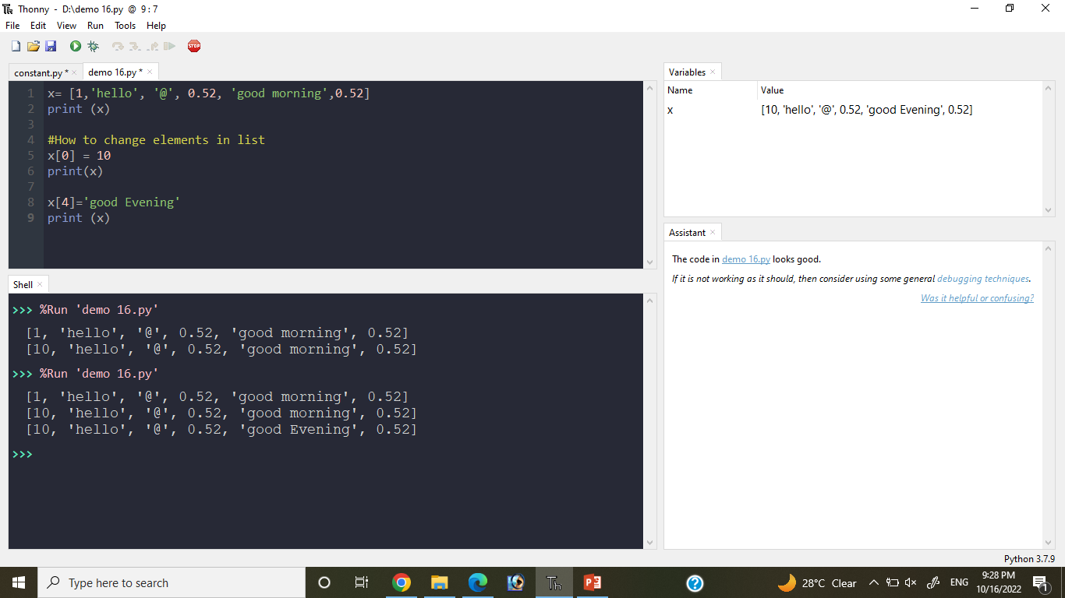

Slide 33
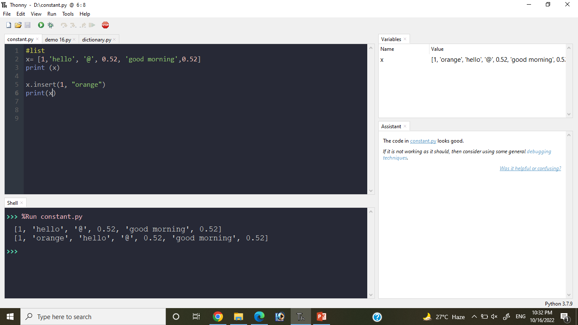
Add Elements

Slide 34
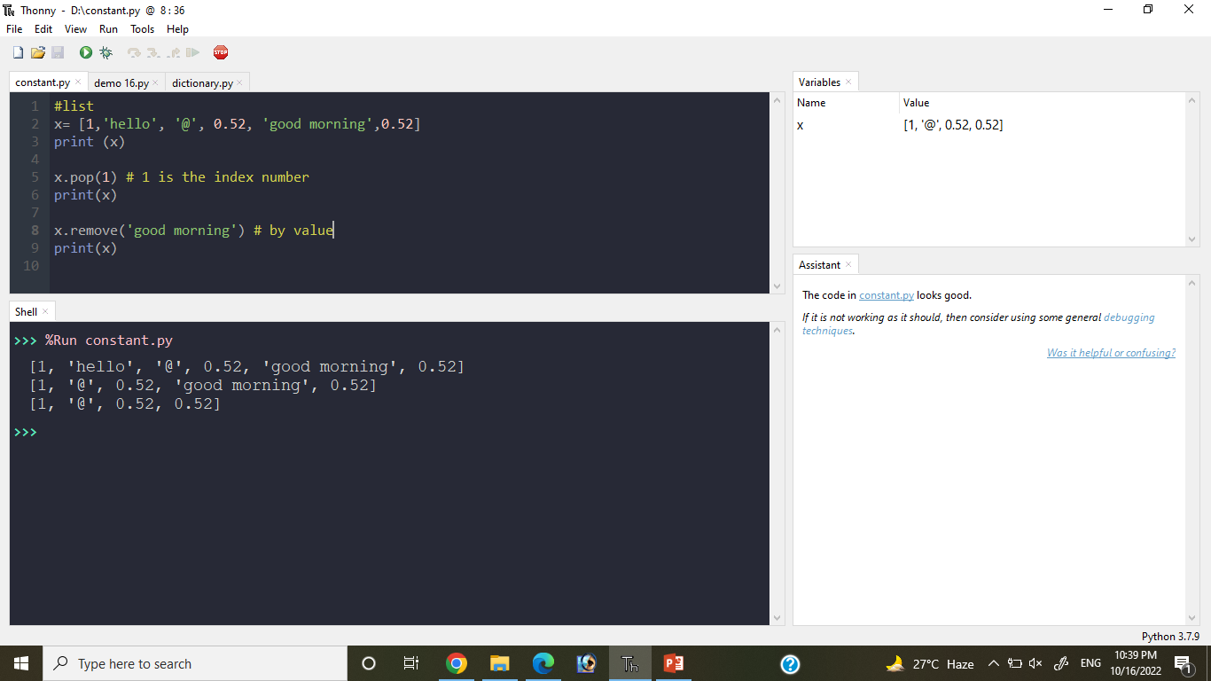
Delete Elements

Slide 35
Tuple
x= (1,'hello', '@', 0.52, 'good morning')
Tuple items are ordered, unchangeable(immutable), and allow duplicate values.
Tuple items can be of any data type

Slide 36


Slide 37
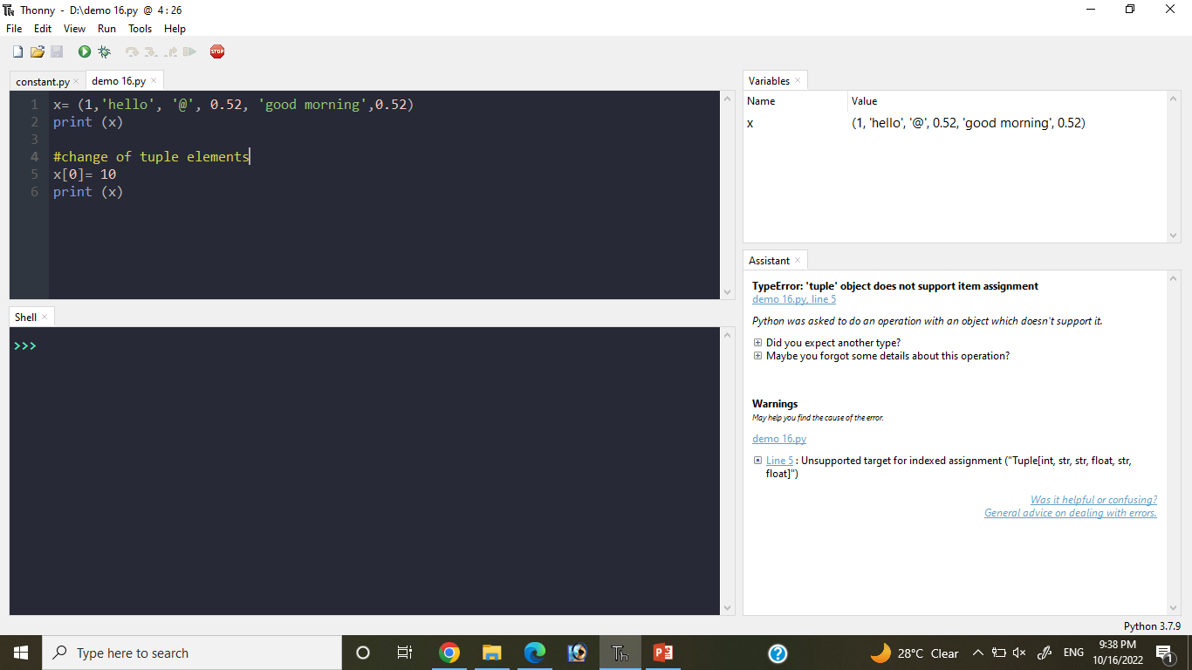
Is change is possible in Tuple

Slide 38
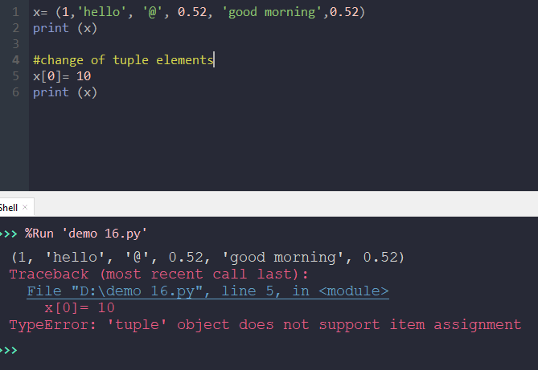

Slide 39
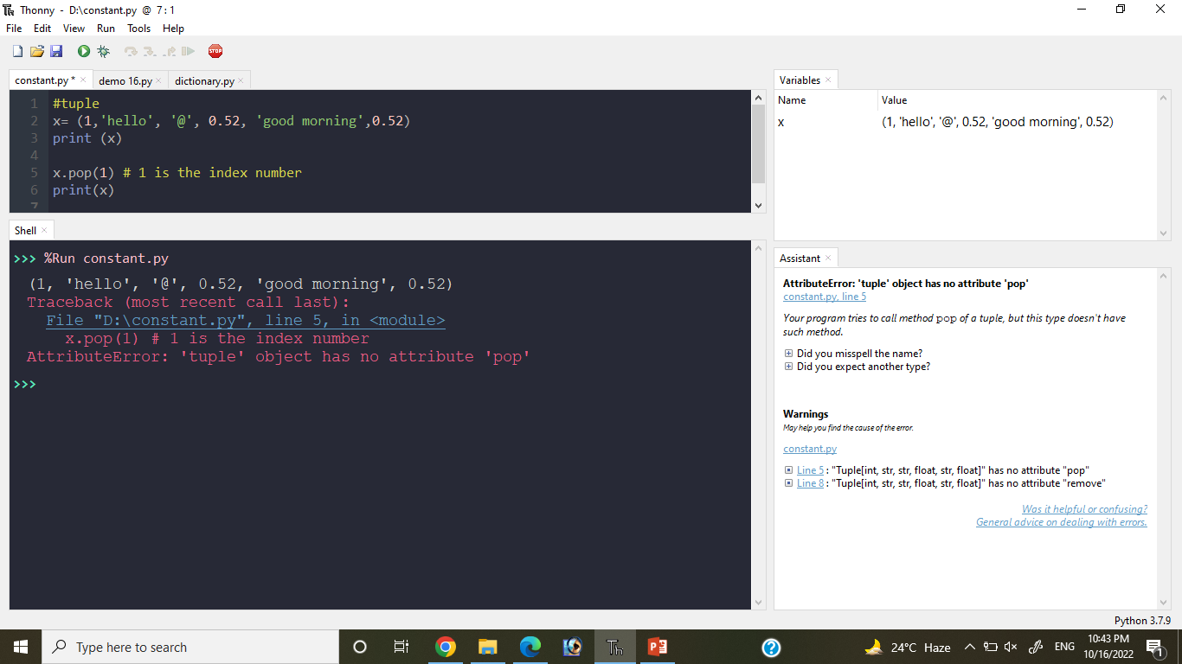
Add or Delete elements in Tuple
Tuples are unchangeable, meaning that we cannot change, add or remove items after the tuple has been created.

Slide 40
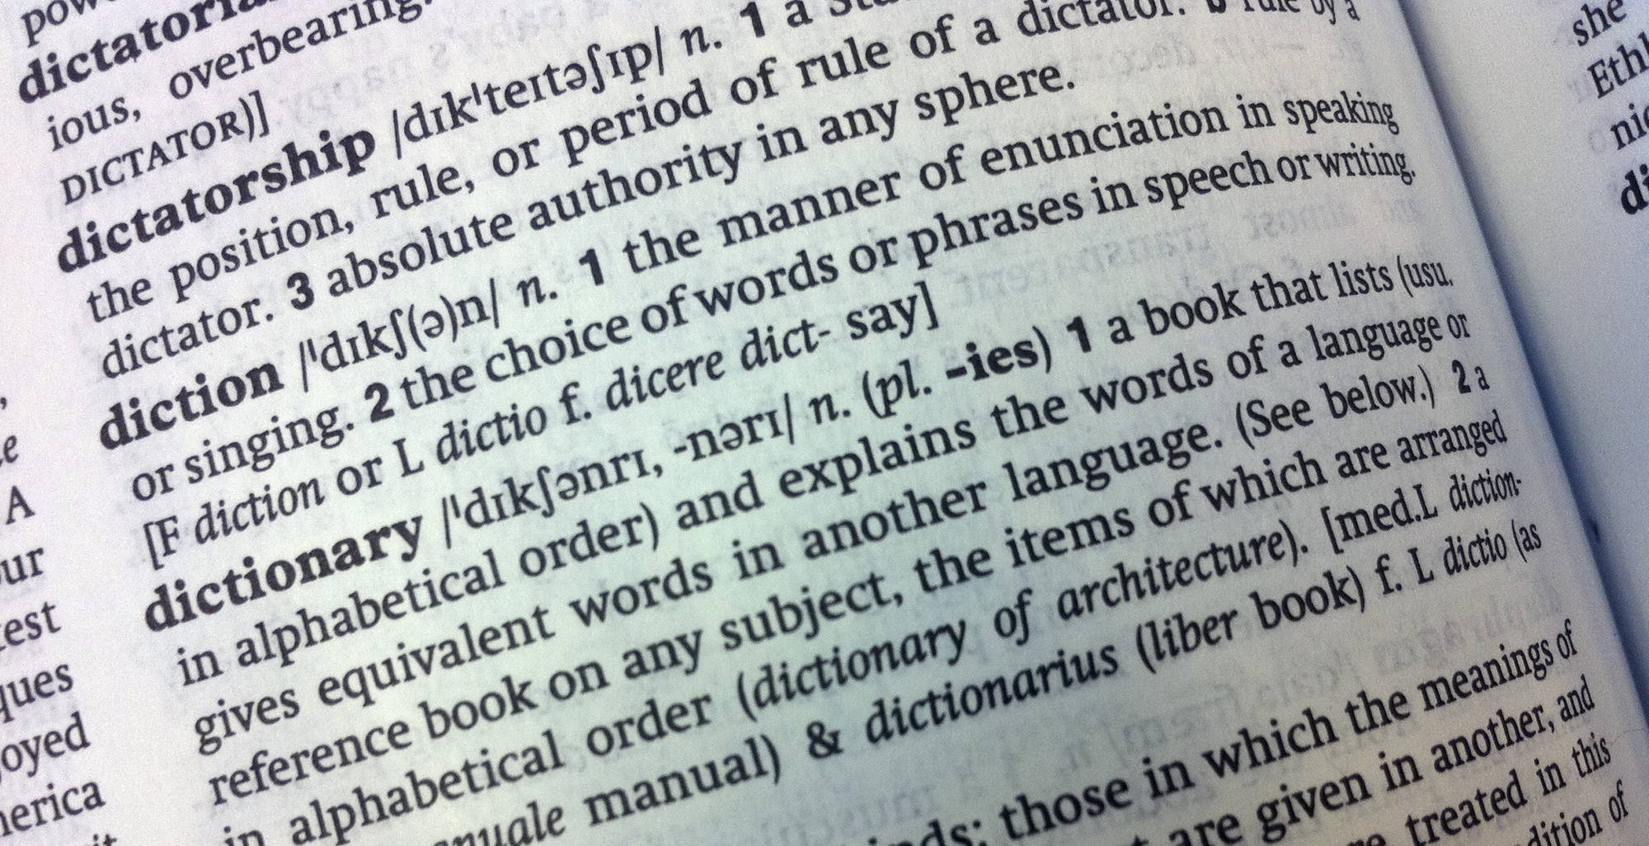
Dictionary
Dictionaries are used to store data values in key : value pairs.
Dictionary items are ordered, changeable, and does not allow duplicates.

Slide 41
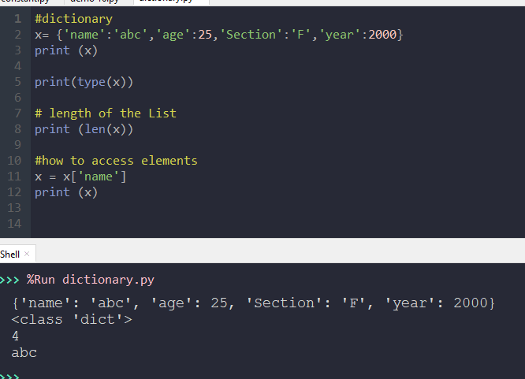

Slide 42
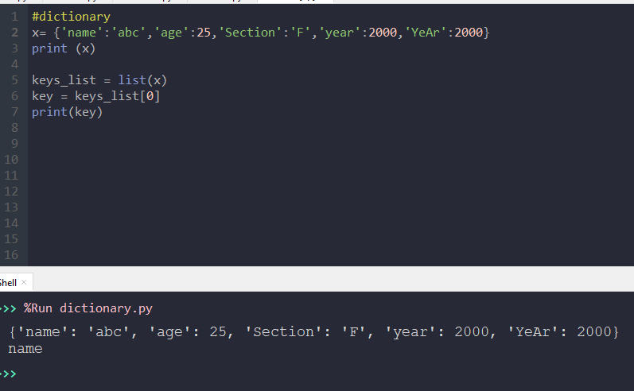

Slide 43
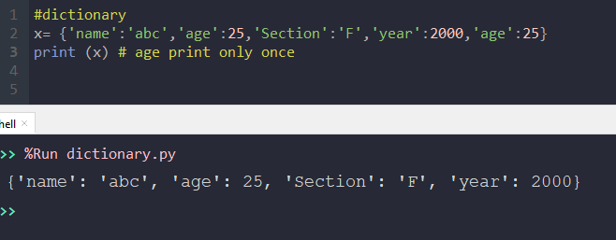
No Duplication

Slide 44
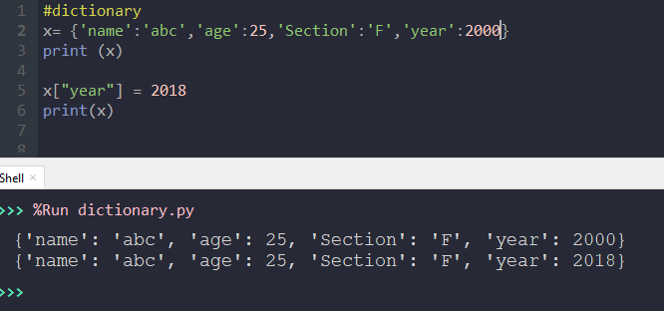
Change of value

Slide 45
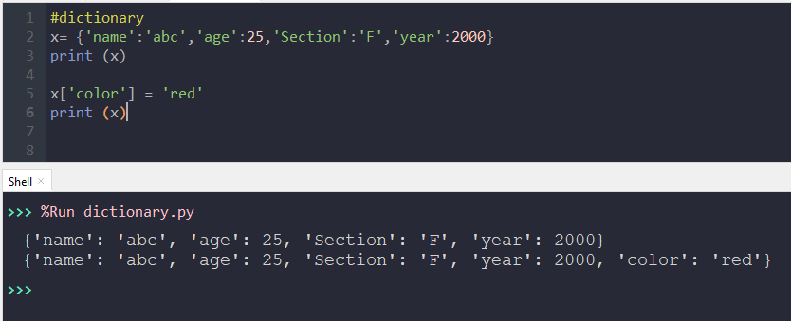
Add Elements

Slide 46

Delete Elements
Function pop is used to delete elements

Slide 47
Operators
Operators are used to perform operations on variables and values.
Python divides the operators in the following groups:
Arithmetic operators
Assignment operators
Comparison operators
Logical operators
Membership operators
Bitwise operators

Slide 48
Arithmetic Operators
Arithmetic operators are used with numeric values to perform common mathematical operations:
Operator | Name | Example
+ | Addition | x + y
- | Subtraction | x - y
* | Multiplication | x * y
/ | Division | x / y
% | Modulus | x % y
** | Exponentiation | x ** y
// | Floor division | x // y

Slide 49
Relational/Comparison operators
Comparison operators are used to compare two values:
Operator | Name | Example
= = | Equal | x = = y
!= | Not equal | x != y
> | Greater than | x > y
< | Less than | x < y
>= | Greater than or equal to | x >= y
<= | Less than or equal to | x <= y

Slide 50
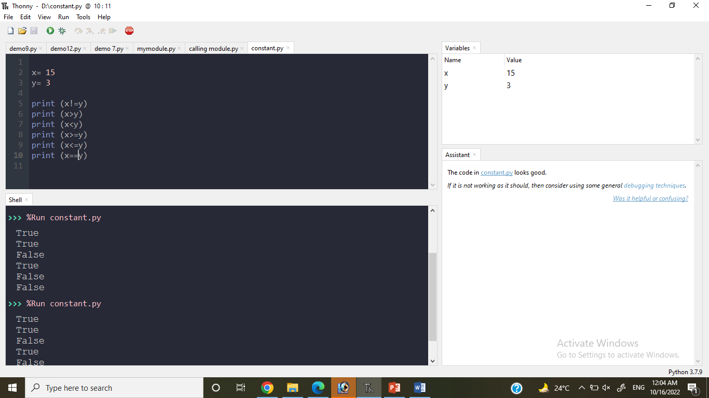

Slide 51
Logical Operators
Logical operators are used to combine conditional statements:
Operator | Name | Example
and | Return True if both statements are true | x < 5 and x < 10
or | Return True if one of the statements is true | x < 5 or x < 4
not | Reverse the result, returns False if the result is true | not (x<5 and x< 10)

Slide 52
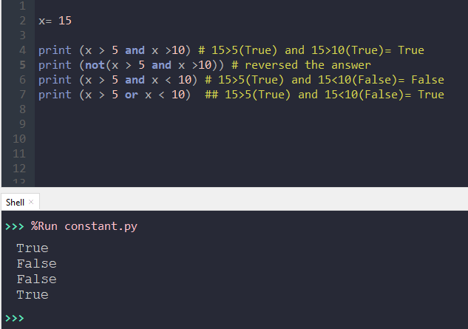

Slide 53
Assignment Operators
Assignment operators are used to assign values to variables:
Operator | Example | Same As
= | x = 5 | x = 5
+= | x += 3 | x = x + 3
-= | x -= 3 | x = x - 3
*= | x *= 3 | x = x * 3
/= | x /= 3 | x = x / 3
%= | x %= 3 | x = x % 3
**= | x **= 3 | x = x ** 3

Slide 54
Scientific Notation
Floating-point literals can also be specified in scientific notation, for example,
1.23456e+2, same as 1.23456e2, is equivalent to 123.456, and
1.23456e-2 is equivalent to 0.0123456.
E (or e) represents an exponent and it can be either in lowercase or uppercase.

Slide 55
Arithmetic Expressions
is translated to
(3+4*x)/5 – 10*(y-5)*(a+b+c)/x + 9*(4/x + (9+x)/y)

Slide 56
Order of Evaluation
When we string operators together - Python must know which one to do first
This is called “operator precedence”
Precedence = Priority
Which operator “takes precedence” over the others.
x = 1 + 2 ** 3 / 4 * 5

Slide 57
Operators Precedence Rules
Highest precedence rule to lowest precedence rule
Parenthesis are always respected
Exponentiation (raise to a power)
Multiplication, Division, and Remainder
Addition and Subtraction
Left to right
Parenthesis
Power
Multiplication
Addition
Left to Right

Slide 58

1 + 2 ** 3 / 4 * 5
1 + 8 / 4 * 5
Parenthesis
Power
Division, Multiplication
Addition,subtraction
Left to Right
1 + 2 * 5
1 + 10
11
>>> x = 1 + 2 ** 3 / 4 * 5
>>> print(x)
11

Slide 59
Exercise (Homework)
Perform the following with Operators Precedence Rules:
(3 + 4) * (4 + 5) * (4 + 3) – 1
2 * 2 – 3 > 2 or 4 – 2 > 5
(2 % 2) + (2 * 2) – (2 / 2)

